Slide 1

Design and Implementation of a Road Sign and Road State Mobile Notification Application
GROUP 15
1
TASK 2

Slide 2
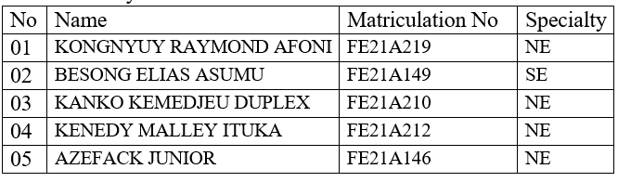
Members

Slide 3
OUTLINE
01
02
03
INTRODUCTION ON THE PROJECT
REQUIREMENT GATHERING TECHNIQUES
REASONS FOR REQUIREMENT GATHERING
04
CONCLUSION
2

Slide 4
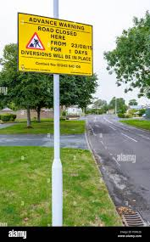
INTRODUCTION
Leveraging technology to provide real time update of road state and road signs to drivers

Slide 5

Requirement Gathering Techniques
User Interviews
Surveys
Brainstorming
Reseach on existing sytems and documents

Slide 6
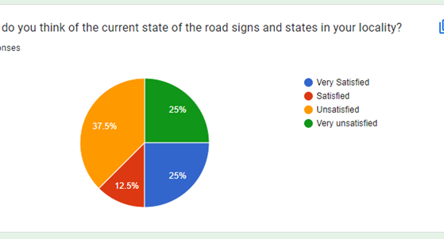
1. Surveys
How often do you encounter unexpected road signs or changes in road conditions while driving?
Would you be interested in receiving notifications for specific types of road signs (e.g., stop signs, speed limit changes)?

Slide 7
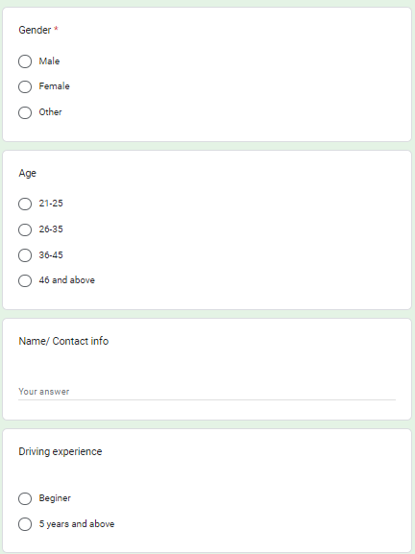
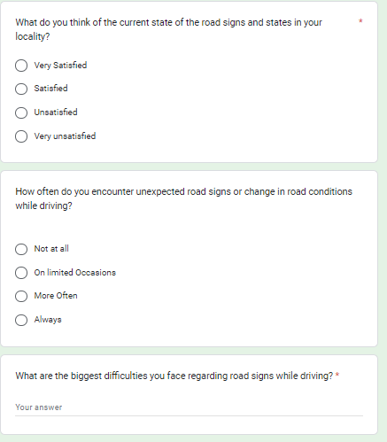

Slide 8
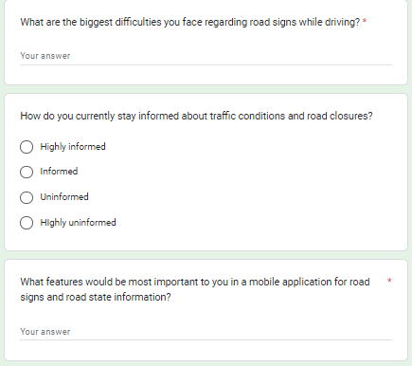
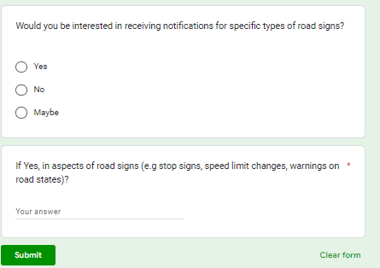

Slide 9
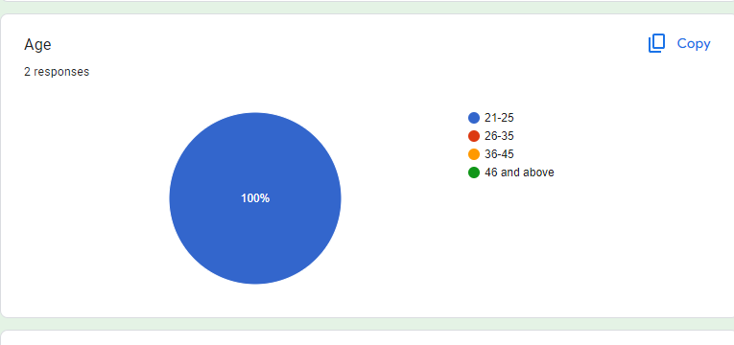
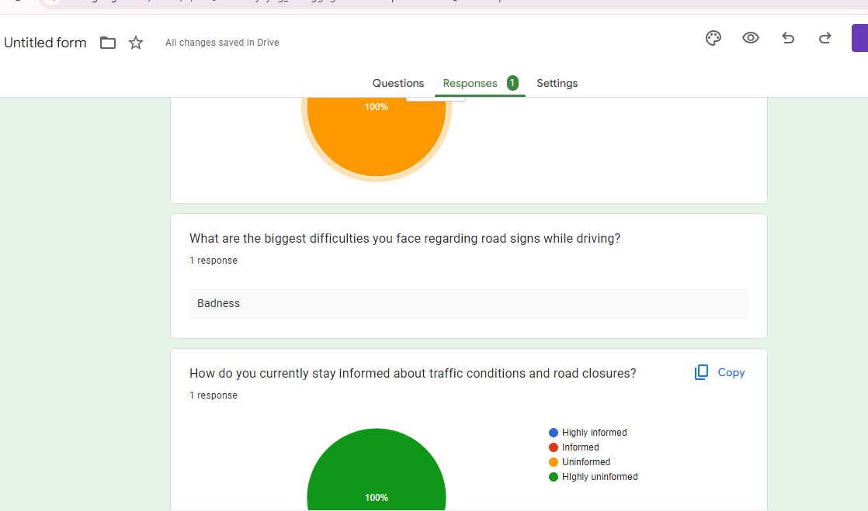
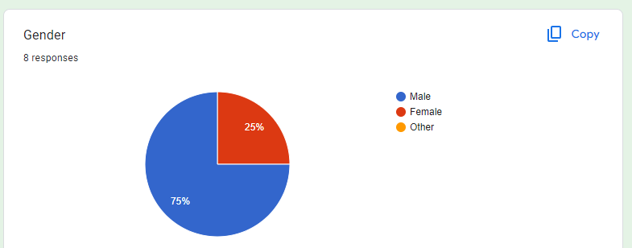
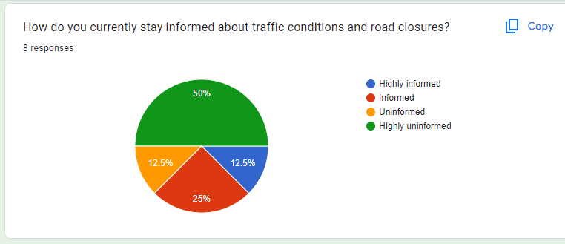
Responses
Minimized Interruptions
Real-time Processing:
Broad User Accessibility
Simple and Responsive Interface
Minimized Driver Distraction
Data Protection
Data Encryption

Slide 10
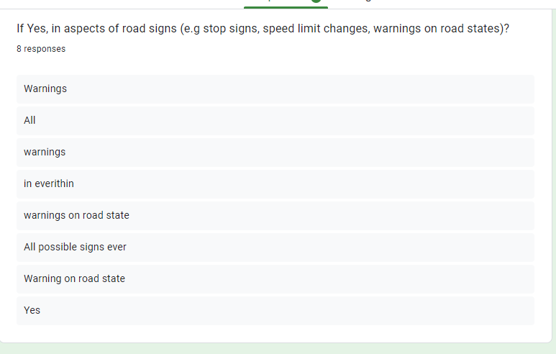
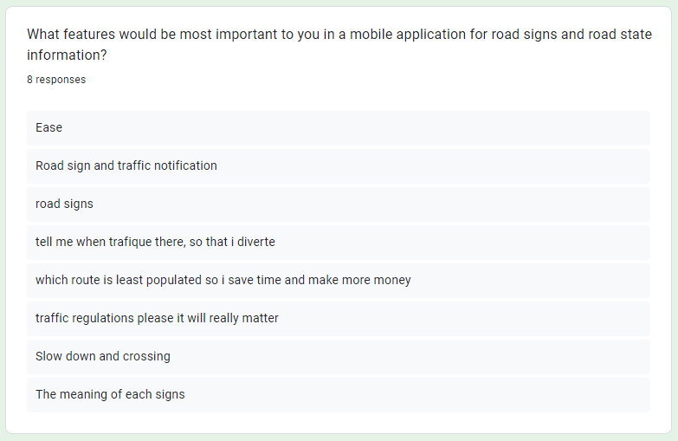
Responses
Minimized Interruptions
Real-time Processing:
Broad User Accessibility
Simple and Responsive Interface
Minimized Driver Distraction
Data Protection
Data Encryption

Slide 11
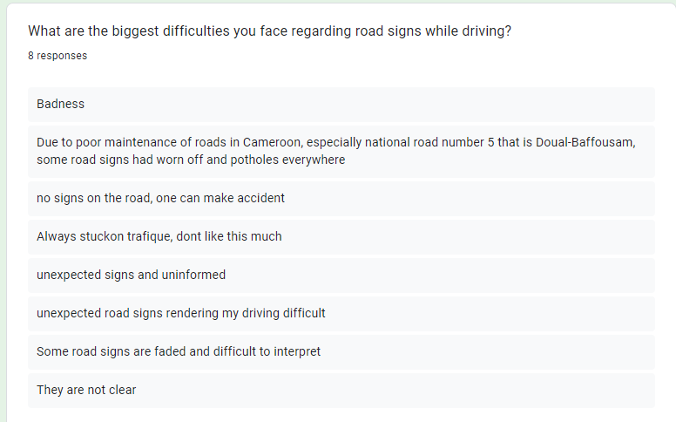
responses
Minimized Interruptions
Real-time Processing:
Broad User Accessibility
Simple and Responsive Interface
Minimized Driver Distraction
Data Protection
Data Encryption

Slide 12
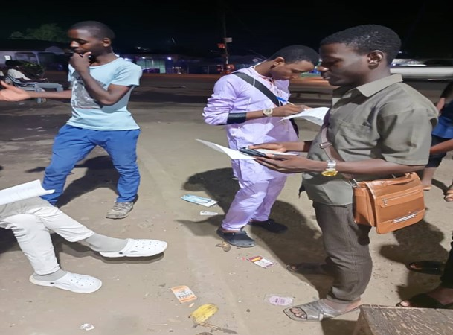
2. Inteviews
What are the biggest difficulties you face regarding road signs while driving?
How do you currently stay informed about traffic conditions and road closures?
What features would be most helpful in a mobile application for road signs and road state information?

Slide 13
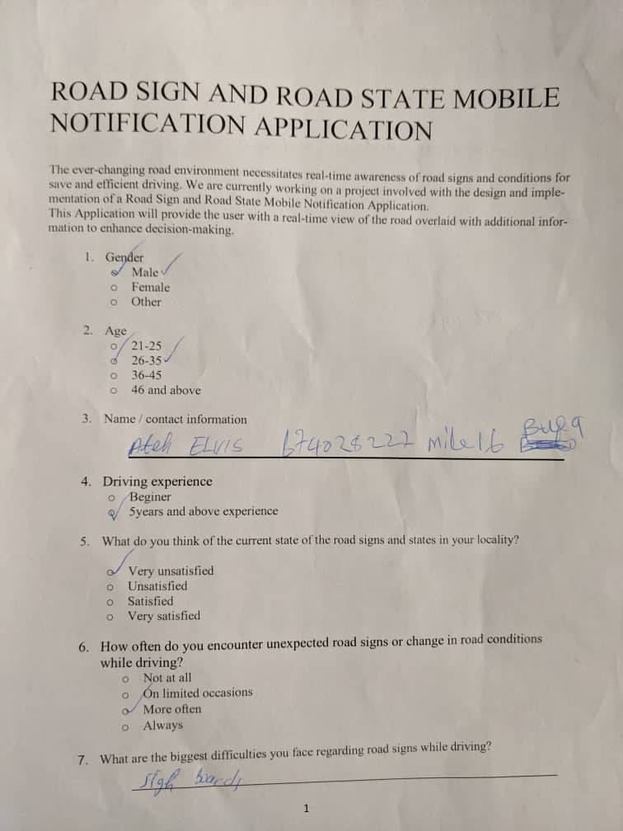
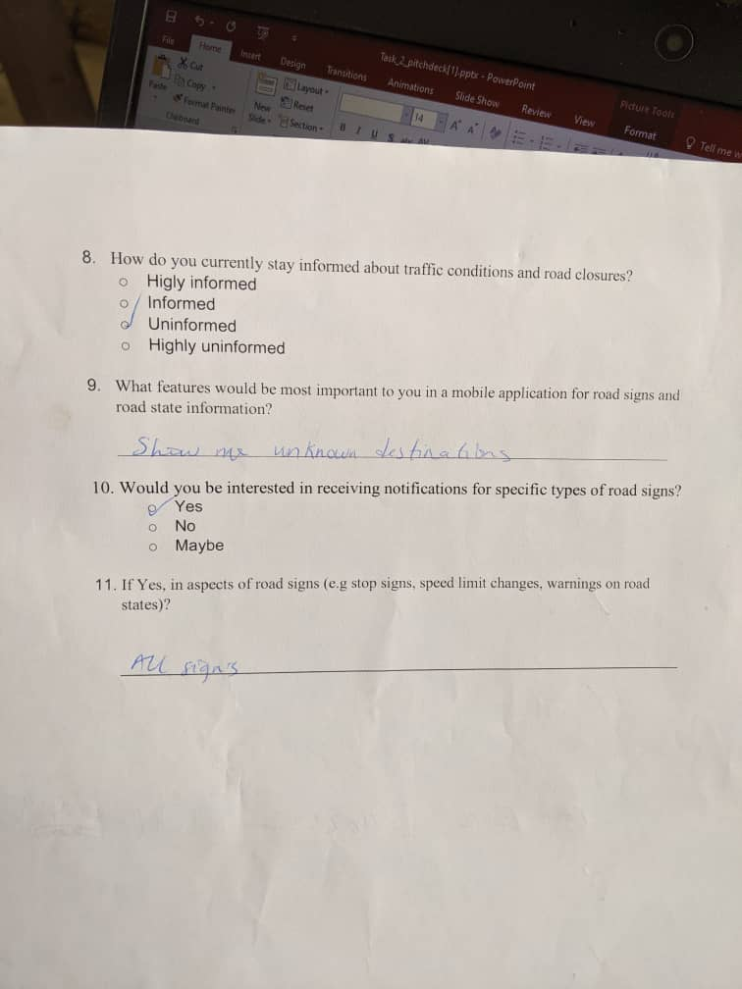
Survey sample question forms

Slide 14
3. Brainstorming
Minimized Interruptions
Real-time Processing:
Broad User Accessibility
Simple and Responsive Interface
Minimized Driver Distraction
Data Protection
Data Encryption

Slide 15
4. Research on existing systems and document
Real-time Road Sign Recognition:
Location-Aware Information and Navigation:
Traffic Light and Sign Detection:
Pedestrian Detection (Optional):
User Reporting:
Route Planning:
User Profiles:

Slide 16


REASONS FOR REQUIREMENT GATHERING
1. Ensure stakeholder alignment
2. Reduces the risk of project failure
3. Addresses Regulatory Concerns
Requirement gathering uncovers any legal or regulatory requirements related to the app's functionality
ensure that everyone is on the same page about what the system needs to do and how it should work
project failure, wasted resources, and damage to the reputation of the development team

Slide 17
NEED FOR REQUIREMENT GATHERING SPECIFICALLY ON PROJECT
Understanding Driver Needs:
Ensuring Road Safety
Avoiding Feature Creep and Cost Overruns
Developing a User-Friendly Interface

Slide 18

MAJOR CHALLENGES

Slide 19
CONCLUSION
Through interviews, surveys, and other methods, we identified potential system and user requirements to ensure the application addresses user needs for our system, and lays the groundground for a successful Requirement analysis and design of an application that empowers drivers and improves overall road safety.

Slide 20

THANK
YOU!!!!!

